Slide 1

Debug and StringBuilder
Lecturer
Rokas Slaboševičius
Data

Slide 2
Today you will learn
Debug and StringBuilder
Debug in VisualStudio
Debug Immediate Window
01
04
Debug VisualStudio Interface
StringBuilder
02
05
Debug Break Points
StopWatch Benchmark measurement
03
06

Slide 3



Debug in VisualStudio
Debug and StringBuilder
When debugging or programming software, it is impossible to avoid mistakes or unexpected situations that may arise.
Tools such as Visual Studio are becoming very useful. "Visual Studio offers a powerful set of tools for debugging and debugging, including debugging functions.

Slide 4
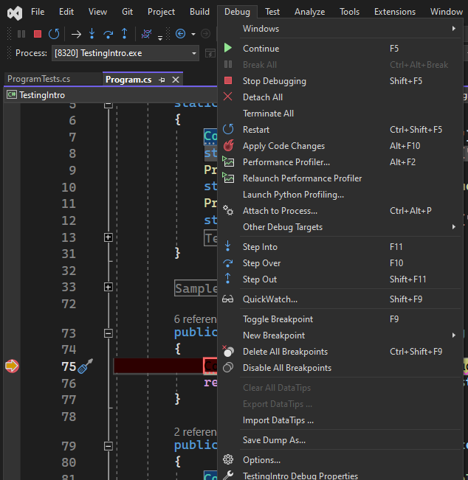
Debug VisualStudio Interface
Debug and StringBuilder
Visual Studio's debugging features allow the programmer to monitor and analyse the code step by step.
The main objective is to find and fix bugs, improving the performance and functionality of the software.
When "debugging" with Visual Studio, we can "inspect" the values of variables, temporarily stop the program at a desired location, or even retrieve the then-current data statistics

Slide 5
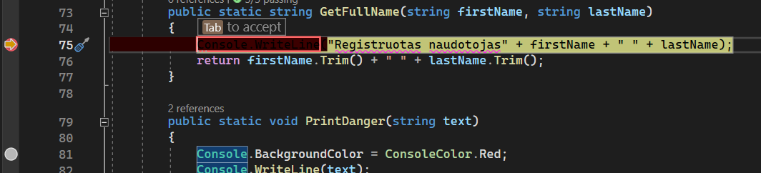
Debug Break Points
Debug and StringBuilder
When debugging software, you may encounter situations where you need to keep a closer eye on the code being executed.
This is where the "break point" becomes a useful tool. A "break point" is a specific point in the code where the program stops during execution, allowing the programmer to view the values of variables and perform other action analysis functions.
When a program reaches a "break point", its execution temporarily stops and the programmer can investigate and understand the state of the program and the code at that time.

Slide 6
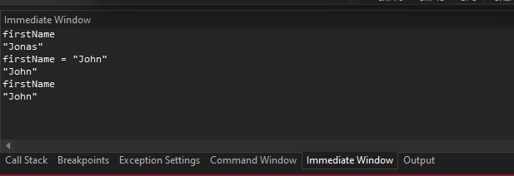
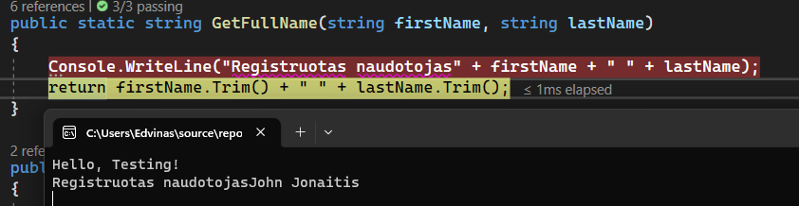
Debug Immediate Window
Debug and StringBuilder
Visual Studio's Immediate Window is a powerful and handy tool for developers to debug their code.
This is an interactive window that allows you to directly execute C# code snippets and view their results.

Slide 7
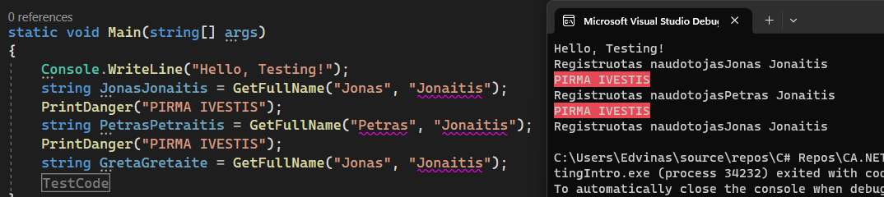
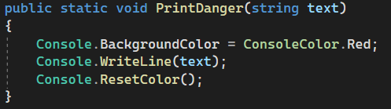
Debug Logging
Debug and StringBuilder
Simple "logging" is an important practice in programming, as it helps to track and record information about the execution of a programme.
This is the process by which important messages, notifications or data about the status of an application are recorded in a particular logging system.
Simple "logging" helps the programmer to understand how the program behaves and to troubleshoot possible errors.

Slide 8

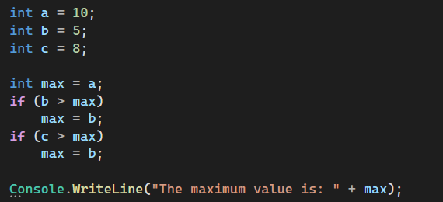
Debug and StringBuilder
Task 1
Use debugging to find the error in the code:

Slide 9
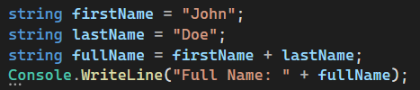
Debug and StringBuilder
Task 2
Use debugging to find the error in the code:

Slide 10
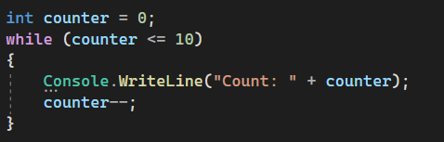
Debug and StringBuilder
Task 3
The program should count from 1 to 10. Correct using debug:

Slide 11
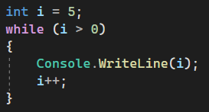
Debug and StringBuilder
Task 4
The program should count from 1 to 5. Correct using debug:

Slide 12
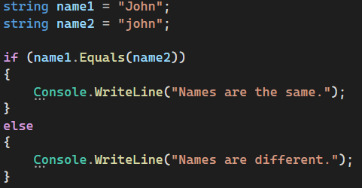
Debug and StringBuilder
Task 5
The app tries to compare two names. Correct using debug:

Slide 13
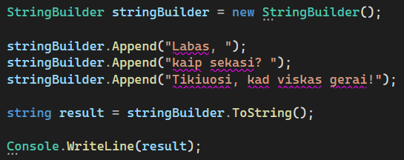
StringBuilder
Debug and StringBuilder
Using StringBuilder instead of string is useful when you need to modify or combine many text elements.
"The StringBuilder class allows for efficient manipulation of text strings, as it provides better performance and lower memory usage than direct string manipulation.
This is especially the case when you have to perform many operations, such as merging text or inserting tags, to create the final text.

Slide 14

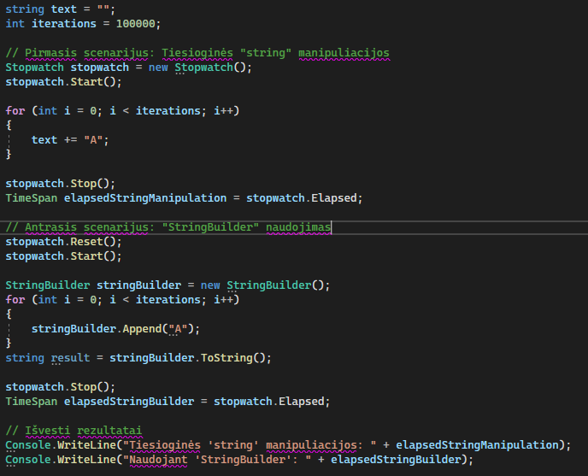
StopWatch
Debug and StringBuilder
"The Stopwatch class is a very useful tool for programmers to measure time and calculate runtime in their programs.
It allows you to measure the time from the start to the end of a given point accurately and conveniently. "The Stopwatch class enables the measurement of very small time intervals

Slide 15

Debug and StringBuilder
Task 6
Write a program that takes a string entered by the user and uses StringBuilder to invert this string. Display the inverted string as a result.
Write a program that takes a string entered by the user and uses StringBuilder to remove all duplicates from this string. Show the modified string as the result, without duplicate characters.

Slide 16
Debug and StringBuilder
Project No 1
Break down the functionality of your Lesson 3 project into individual methods. When creating methods, try to put a strong emphasis on the code under test (Something should come back from the method itself). Write program with the methods.

Slide 17
Debug and StringBuilder
https://learn.microsoft.com/en-us/visualstudio/debugger/debugger-feature-tour?view=vs-2022
https://www.tutorialsteacher.com/articles/how-to-calculate-code-execution-time-in-csharp
Useful information

